Slide 1


By
Abhijeet Singh Kalsi
/in/abhijeetkalsi
Your AI pair
Programmer

Slide 2


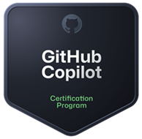
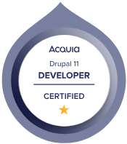
About me …!
With over 14.5 years of experience in programming, analysis, design, and development of web-based applications utilizing Drupal CMS and PHP
I am a Acquia Certified Developer – Drupal 10 & 11.
I am Microsoft Certified GitHub Copilot certification.
I have served as an Architect/Technical Manager at Capgemini.
Contributed many open source module to Drupal
I also have experience as a DevOps professional, managing various application environments through Docker containers hosted on AWS, Acquia Site Factory, and Acquia Cloud.
I collaborate directly with customers and business stakeholders from the American and European regions to capture, define, and address solution requirements.

Slide 3

Microsoft certified GitHub Copilot
URL: https://learn.microsoft.com/en-gb/users/abhijeetkalsi/credentials/895383803228b25a

Slide 4
What is GitHub Copilot
GitHub Copilot is an AI-powered coding assistant developed by GitHub (owned by Microsoft) in collaboration with OpenAI. It helps developers write code faster by suggesting whole lines or blocks of code directly inside their editor (like VS Code, JetBrains IDEs, Neovim, etc.).
What it does
Code autocompletion: Suggests entire lines or functions as you type.
Context-aware help: Understands the file, function, and project context to give relevant suggestions.
Learns coding style: Adapts to your variable names, patterns, and frameworks over time.
Supports many languages: Works best with Python, JavaScript, TypeScript, Go, C#, Java, PHP, and more.
Natural language to code: You can write a comment like "create a function to sort a list of users by age" and it will generate the function.

Slide 5


Slide 6
Prompt engineering
Single: Always focus your prompt on a single, well-defined task or question. This clarity is crucial for eliciting accurate and useful responses from Copilot.
Specific: Ensure that your instructions are explicit and detailed. Specificity leads to more applicable and precise code suggestions.
Short: While being specific, keep prompts concise and to the point. This balance ensures clarity without overloading Copilot or complicating the interaction.
Surround: Utilize descriptive filenames and keep related files open. This provides Copilot with rich context, leading to more tailored code suggestions.

Slide 7
Prompt types supported by GitHub Copilot Chat
Direct Questions: You can ask specific questions about coding concepts, libraries, or troubleshooting issues. For example, "How do I implement a quick sort algorithm in PHP/Java?" or "Why is my React component not rendering?“
Code-Related Requests: You can request code generation, modification, or explanation. Examples include "Write a function to calculate factorial," "Fix this error in my code," or "Explain this code snippet.“
Open-Ended Queries: You can explore coding concepts or seek general guidance by asking open-ended questions like "What are the best practices for writing clean code?" or "How can I improve the performance of my Python application?“
Contextual Prompts: You can provide code snippets or describe specific coding scenarios to seek tailored assistance. For instance, "Here's a part of my code, can you suggest improvements?" or "I'm building a web application, can you help me with the authentication flow?

Slide 8
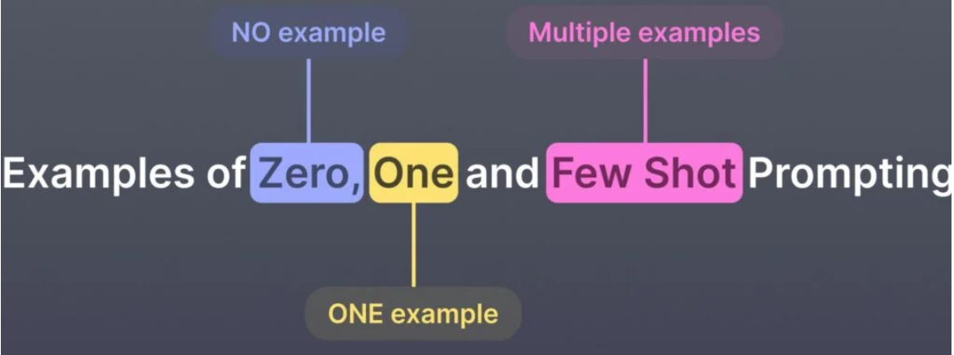

Shot Promoting
One-shot in Copilot
You ask Copilot (or any LLM) to do something without showing any examples.
Copilot will generate the function directly, relying only on its training knowledge.

Slide 9
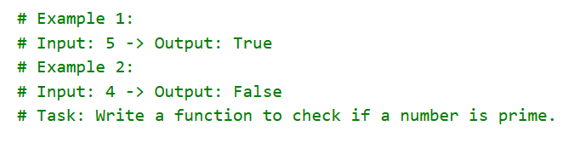
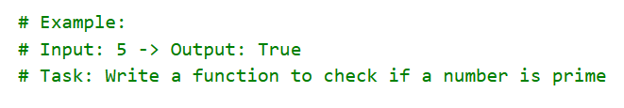


One-shot in Copilot
Few-shot in Copilot
You give one example of how you’d like the task to be solved.
Copilot now understands the pattern better and adjusts output.
You give multiple examples to guide Copilot’s style or logic.
With these examples, Copilot is much more likely to give you exactly the function you want.

Slide 10
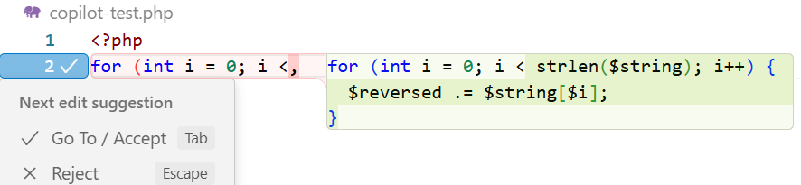
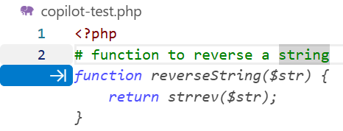
NLP (Natural Language Processing) Features in Copilot
Code Completion (Language Modelling)
Uses next-token prediction (just like predicting the next word in English).
E.g., if you type for (int i = 0; i <, it predicts the rest of the loop.
2) Natural Language to Code (NL → Code)
You can write:
# function to reverse a string
Copilot reads the natural language comment and generates code.
This is NLP semantic parsing: turning intent into structured code.

Slide 11
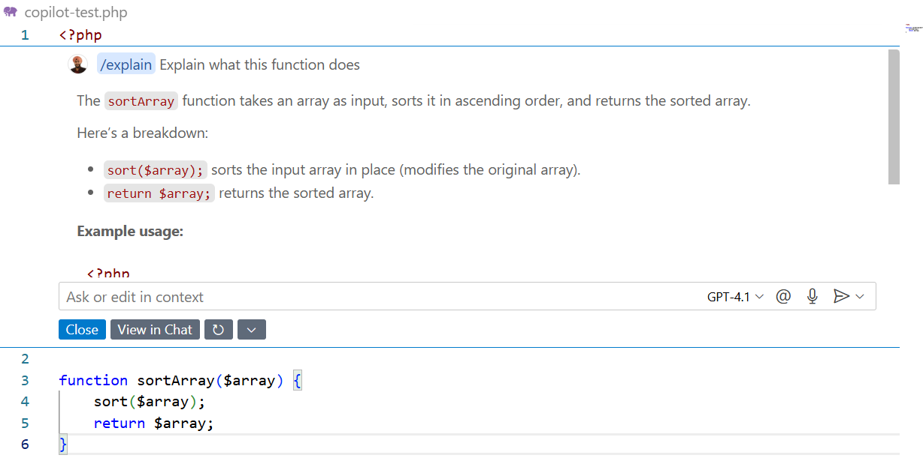
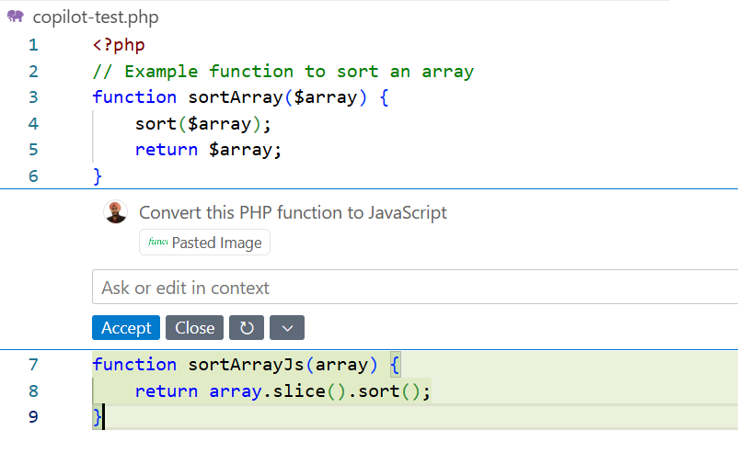
3) Code Explanation (Code → NL)
In Copilot Chat:
Explain what this function does → Copilot summarises in plain English.
This is NLP summarisation.
4) Code Translation (NL + Code)
“Convert this PHP function to JavaScript” →
Copilot uses NLP-style translation between languages.

Slide 12
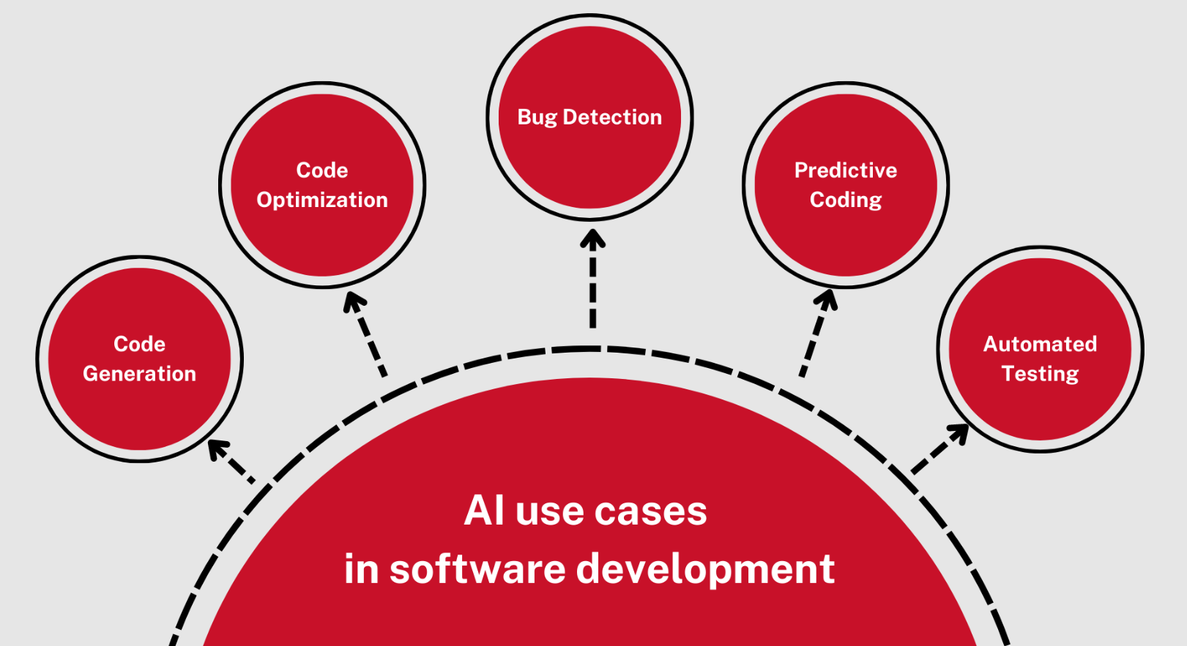

Slide 13

Developer Use Cases for GitHub Copilot
Code Generation & Autocompletion
Write functions from natural language comments and reduce repetitive code writing.
Code Translation (Polyglot Coding)
Convert code from one language to another (e.g., Python → Java, JavaScript → TypeScript)
Code Explanation & Documentation
Generate docstrings, inline comments, and README snippets
Code Refactoring & Optimisation
Suggest cleaner, more efficient, or modern alternatives. Suggest better data structures
Test Generation
Create unit tests and integration tests from function definitions
Debugging Assistance
Identify potential bugs or edge cases in code and suggest fixes for error messages
DevOps & CLI Automation
Generate shell commands with Copilot CLI (what-the-shell) and explain terminal commands in plain English.

Slide 14
Interact with Copilot
Inline suggestions
Command palette
Copilot chat
Inline chat
Comments to code
Multiple suggestions
Automated test generation

Slide 15
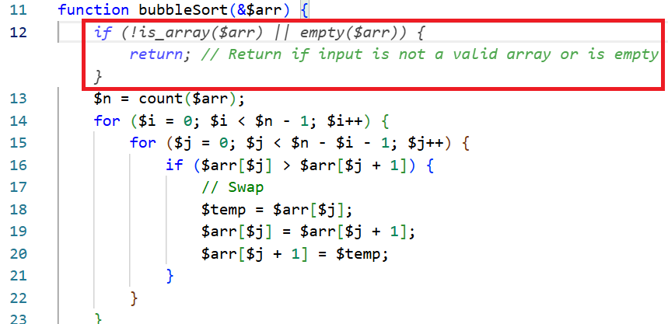
Inline suggestions
The suggestions that Copilot offers appear as grayed-out text ahead of your cursor.
To accept a suggestion, select the Tab key or the > (right arrow) key.
To reject a suggestion, keep typing or select the Esc key.

Slide 16
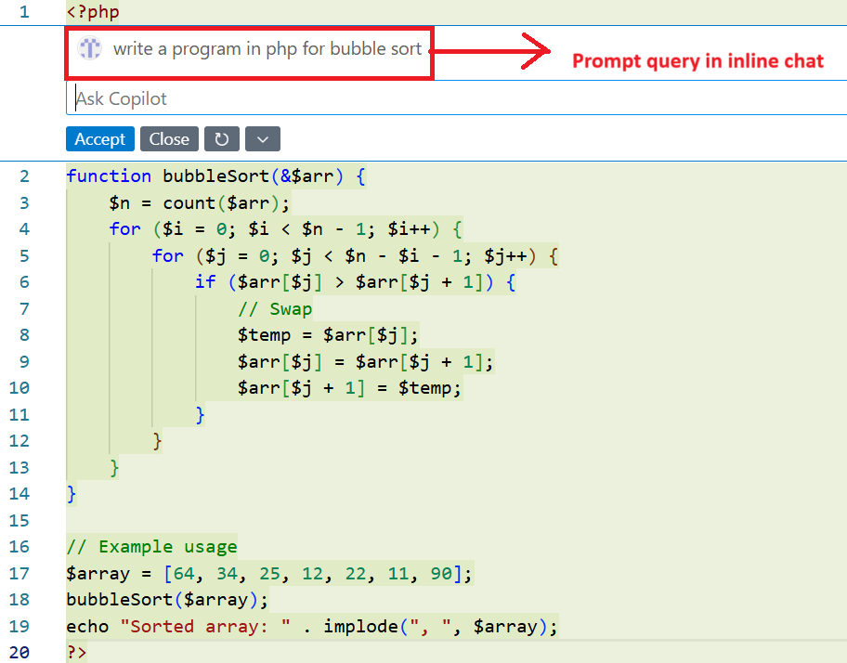
Inline Chat
Place your cursor where you want assistance.
Use the keyboard shortcut Ctrl+I (Windows or Linux) or Cmd+I (Mac) to open inline chat.
Ask questions or request changes specific to that code location.

Slide 17
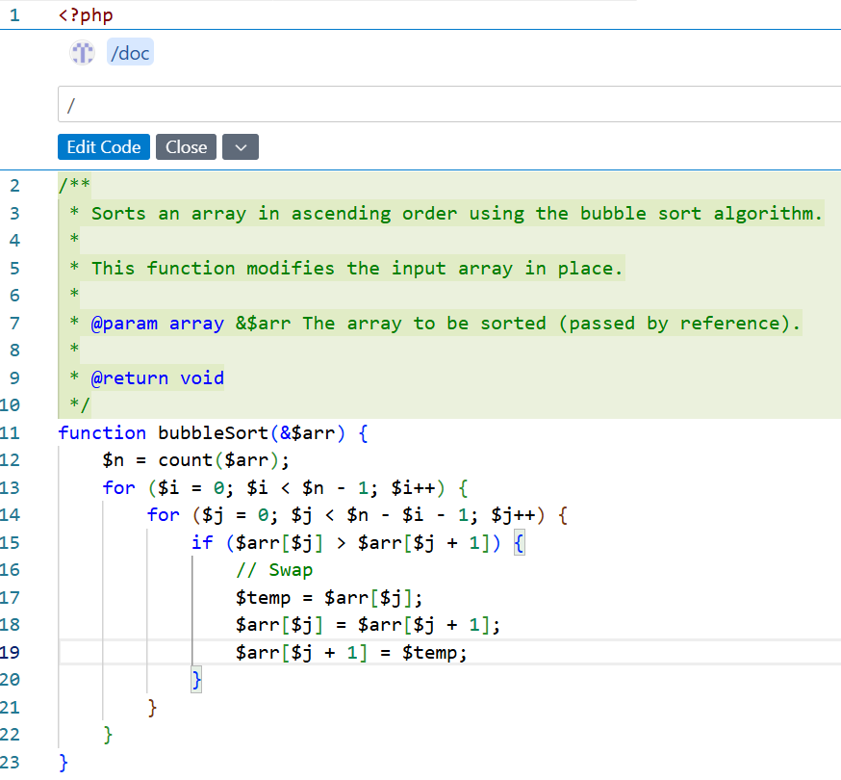
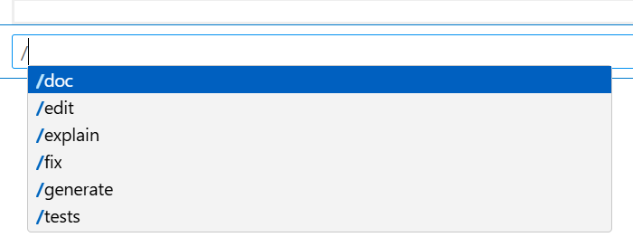
Here are some common slash commands and their usage
/explain - Provides an explanation of the selected code.
/generate - Offers code suggestions based on the current context.
/tests - Generates unit tests for the selected function or class.
/doc - Converts comments into code snippets.

Slide 18
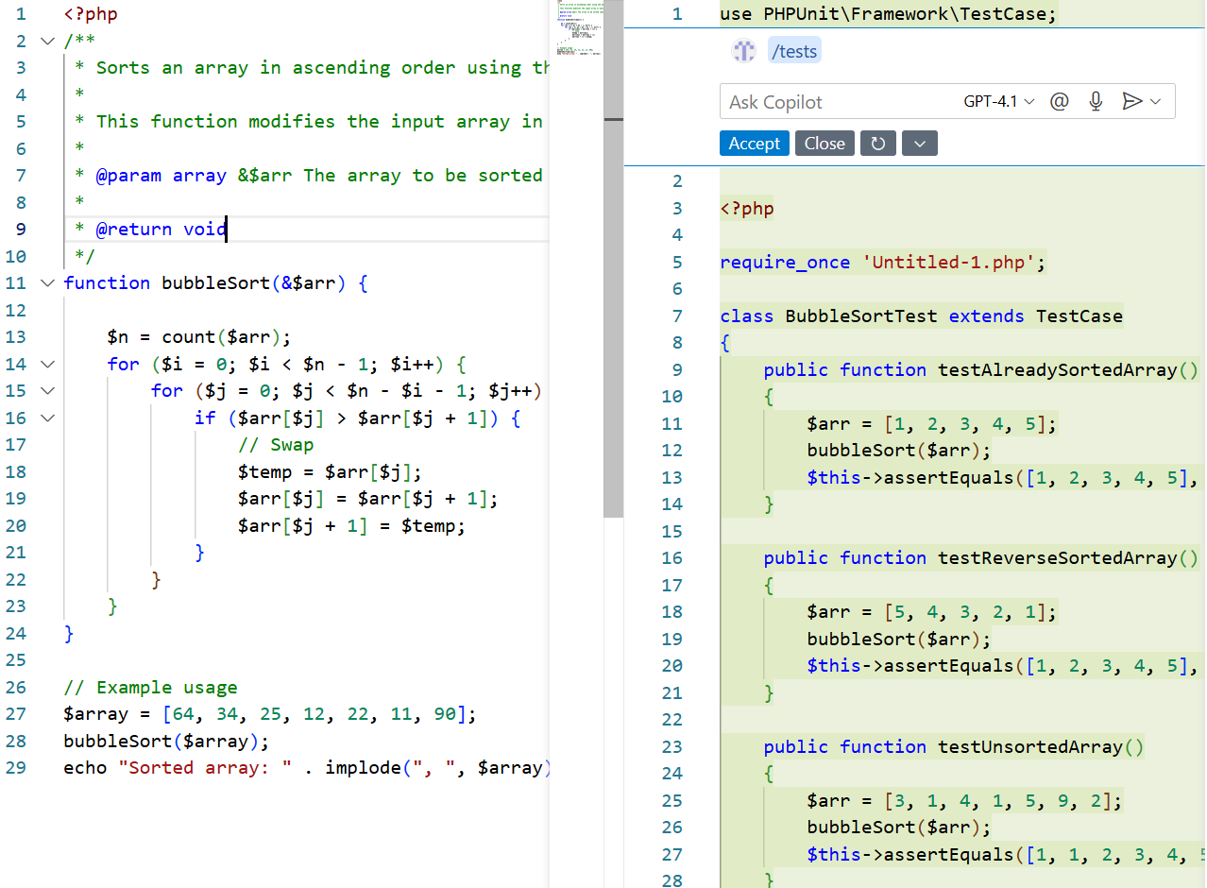
Automated Test generation
Select a function or class.
Use the command palette to select Copilot: Generate Unit Tests.
Review the test cases that Copilot suggests for your code.

Slide 19
GitHub Copilot in the CLI?
GitHub Copilot in the CLI is a GitHub CLI extension that lets you interact with Copilot directly from your terminal. You can:
Get suggestions: Ask for appropriate commands (shell, git, or gh) using natural language.
Get explanations: Ask Copilot to explain unfamiliar commands in plain English.
Execute suggestions: Optionally have Copilot execute suggested commands if you configure it to do so

Slide 20
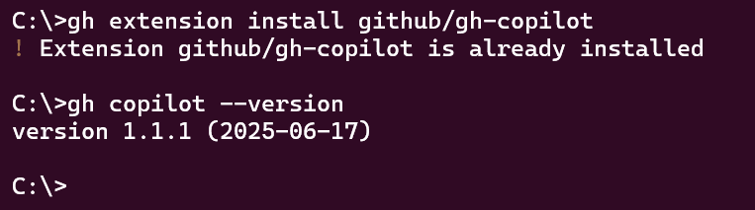
Installation CMD
gh extension install github/gh-copilot

Slide 21
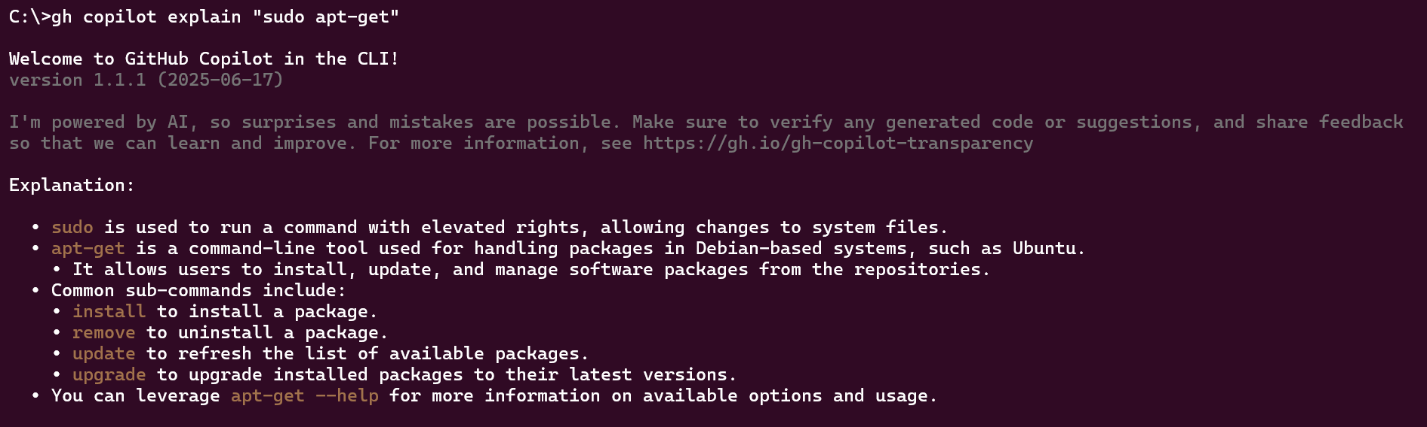
Explain a command: gh copilot explain

Slide 22
Suggest a command: gh copilot suggest

Slide 23


Slide 24
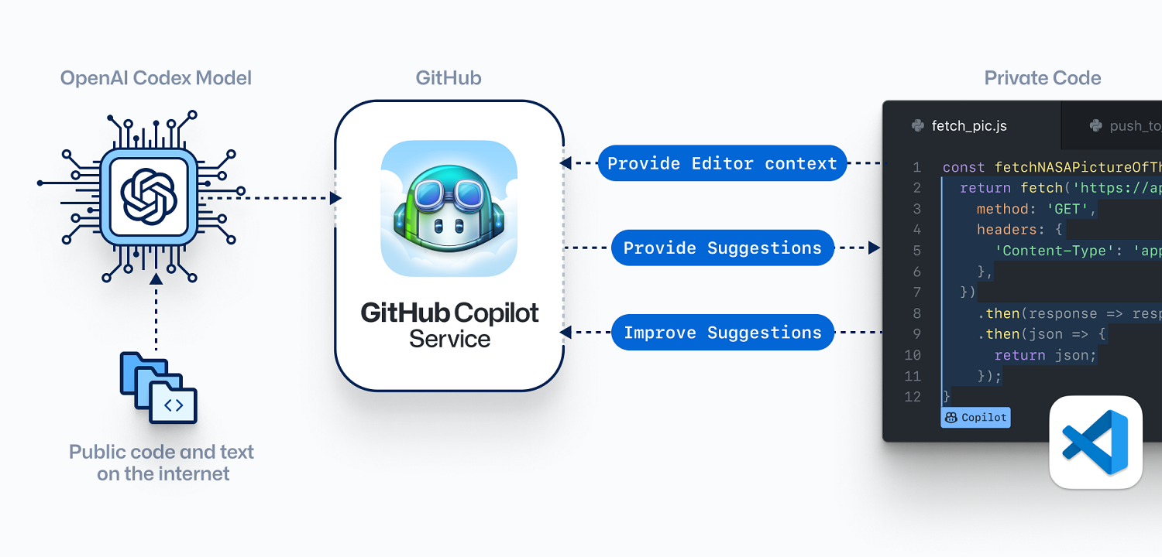
How GitHub Copilot Works: The Workflow
Codex is trained on high-quality code repos on GitHub developed by Microsoft partner OpenAI.
Open AI Codex an improved descendent of GPT-3 (Generative Pre-trained Transformer) that can translate natural language into code.

Slide 25
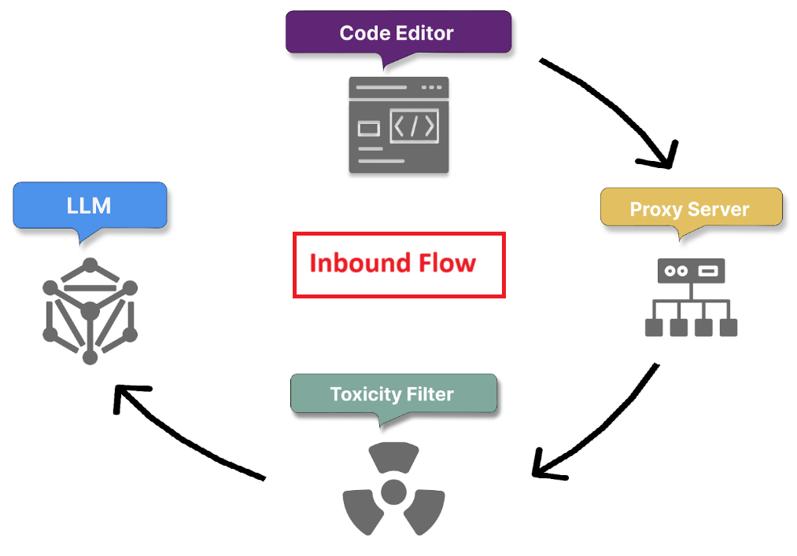
Inbound Flow
Secure prompt transmission and context gathering
Proxy filter - traffic, blocking attempts to hack the prompt
Toxicity filtering (Hate speech, Inappropriate content, Personal data)
Code generation with LLM - generate appropriate code suggestions based on prompt and the surrounding context, ensuring that the generated code is relevant, functional, and aligned with project-specific requirements.

Slide 26
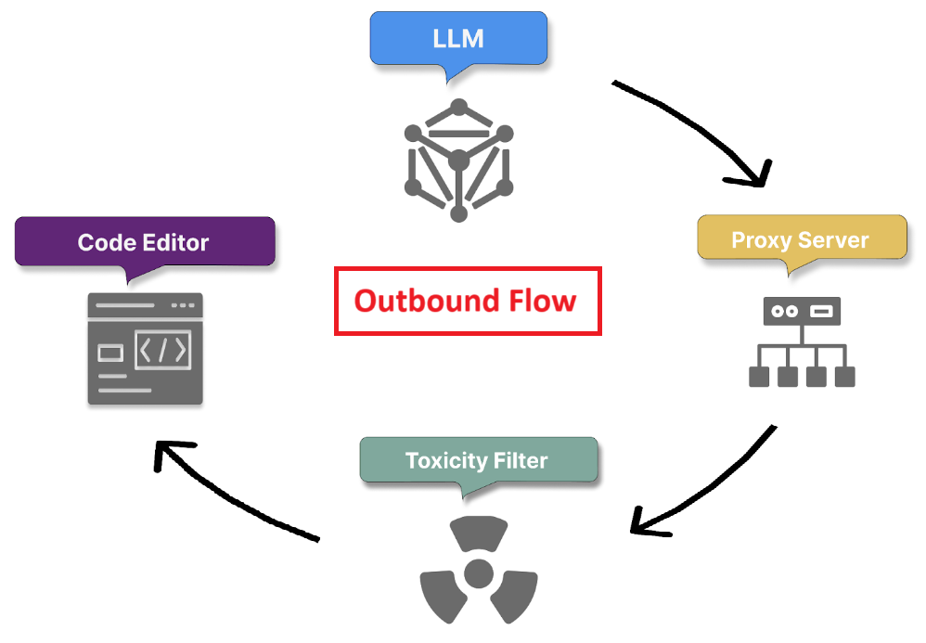
Outbound Flow
Post-processing and response validation
Suggestion delivery and feedback loop initiation

Slide 27
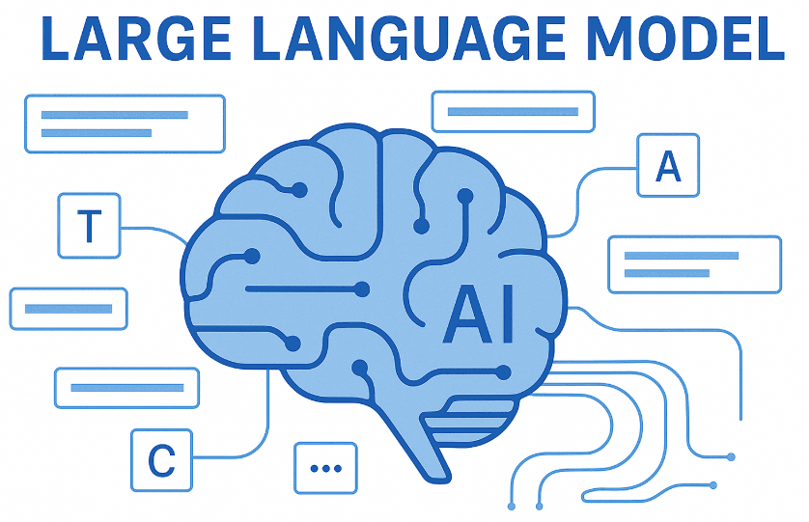
Large Language Model (LLM)
GitHub Copilot is an AI-powered coding assistant developed by GitHub in collaboration with OpenAI.
It uses a large language model (LLM), specifically based on OpenAI Codex, which is a derivative of the GPT (Generative Pre-trained Transformer) series fine-tuned on a large dataset of public code from GitHub and other sources.
powered by more advanced LLMs like GPT-4.

Slide 28
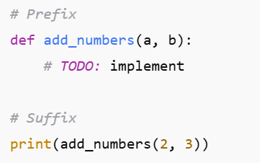
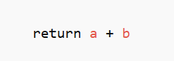
Fill-In-the-Middle (FIM) Model
FIM models are trained to fill in missing code between a prefix and a suffix.
The model fills the gap in the middle
with the correct implementation:
Why FIM is important for Copilot
Developers often edit existing code, not just write from scratch.
FIM allows Copilot to consider both the code before and after the cursor.
This makes suggestions context-aware, improving completions in the middle of a function, class, or file.
How it works
During training, code is randomly split into prefix + middle + suffix.
The model learns to reconstruct the middle given the prefix and suffix.
This makes it more powerful for IDE use cases compared to plain left-to-right models.

Slide 29
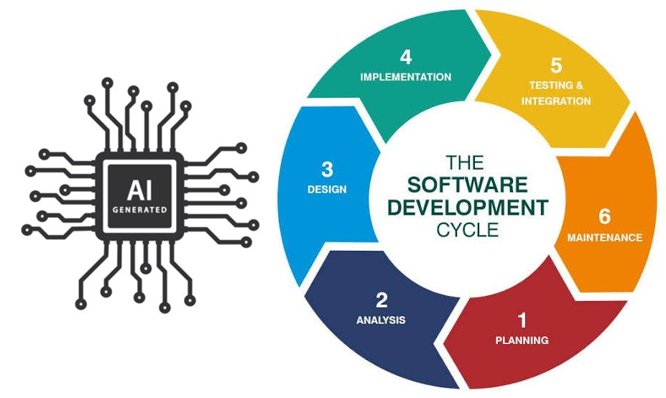

Slide 30
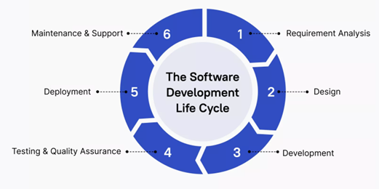
Requirement Analysis
AI in the Software Development Lifecycle (SDLC)
Rapid prototyping: Quickly generate code snippets based on high-level descriptions for faster POC.
User story implementation: Transform user stories into initial function or class definitions, providing a starting point for development.
API design: Suggest API structures based on the described functionality.

Slide 31
2. Design & development
3) Testing & quality assurance
Boilerplate code generation: Automatically create repetitive code structures, saving time on setup tasks.
Unit test creation: Generate test cases based on function signatures and behaviour, ensuring comprehensive test coverage.
Test data generation: Create realistic test data sets, saving time on manual data creation.
Edge case identification: Suggest test scenarios that cover edge cases, improving the robustness of tests.
Assertion suggestions: Propose appropriate assertions based on the expected behavior of the code being tested.
Design pattern implementation: Suggest appropriate design patterns based on the problem context, promoting best practices.
Code optimization: Offer more efficient code alternatives, helping developers write performant code from the start.
Cross-language translation: Assist in translating concepts or code snippets between different programming languages.

Slide 32
4. Deployment
5) Maintenance & support
Rapid prototyping: Quickly generate code snippets based on high-level descriptions, allowing for faster proof-of-concept development.
User story implementation: Transform user stories into initial function or class definitions, providing a starting point for development.
API design: Suggest API structures based on the described functionality, helping to flesh out system architectures.
Bug fix suggestions: Propose potential fixes for reported issues based on error messages and surrounding code.
Code refactoring: Suggest improvements to existing code, helping to keep the codebase modern and efficient.
Documentation updates: Assist in keeping code comments and documentation in sync with changes.
Legacy code understanding: Help developers understand and work with unfamiliar or legacy code by providing explanations and modern equivalents.

Slide 33
Copilot Feature Comparison by Plan
Plans | Price (USD) | Completions | Premium Requests | Chat & Agent Mode | Models (Quality & Access) | Admin / Org Controls
Free | $0 | 2,000/month | 50/month | Limited | Basic models (Claude 3.5, etc.) | None
Pro | $10/mo or $100/yr | Unlimited | 300/month + pay extras | Full | GPT-5 mini, Gemini 2.5 Pro, etc. | None + student/open-source perks
Pro+ | $39/mo or $390/yr | Unlimited | 1,500/month + extras | Full | All models + Spark preview | None
Business | $19/user/mo | Unlimited | 300/user/month | Full | Similar to Pro+ | Admin controls, metrics, privacy
Enterprise | $39/user/mo | Unlimited | 1,000/user/month | Full | All models + advanced capabilities | Full enterprise controls

Slide 34
Privacy & Data Use
Your prompts and suggestions are not visible to GitHub or any admin.
Copilot may collect limited telemetry (e.g., performance data, error logs, and aggregate usage counts like “number of completions generated”), but not the actual code you write.
For Business / Enterprise Plans, what they do get is:
Usage metrics (e.g., how many completions or chat requests a user made).
Billing and quota consumption.
Policy controls (like disabling certain Copilot features, managing access, or setting org-wide preferences).
No raw code, prompts, or suggestions are exposed in these reports.
For Copilot Business/Enterprise, no customer data is used for training.
Conclusion
No one at GitHub can see your private prompts/suggestions unless you explicitly share code.

Slide 35

Human-in-the-Loop
Copilot is an assistant, not a replacement for developers.
Final accountability lies with the developer to:
Review suggestions.
Check security, licensing, and correctness.
GitHub emphasises that AI is a coding partner, not an autopilot.
That’s why GitHub called its AI tool Copilot, not Autopilot.

Slide 36

Main Limitations of GitHub Copilot
Code Quality & Reliability - syntactically correct but semantically flawed, inefficient, requiring careful human review.
Security & Vulnerability Risks - improper randomness, code injection, or cross-site scripting
Intellectual Property & Licensing Issues - too similar to copyrighted examples, raising legal and licensing concerns.
Limited Contextual & Architectural Understanding – Lack of project’s full architecture &, edge cases or unique project patterns
Privacy & Data Sensitivity - exposing sensitive or proprietary code.
Performance & Operational Constraints

Slide 37

Questions & Answers

Slide 38

References
https://learn.microsoft.com/en-us/training/modules/introduction-to-github-copilot
https://learn.microsoft.com/en-us/training/paths/gh-copilot-2/
https://docs.github.com/en/copilot/get-started/what-is-github-copilot

